Slide 1


NUMERICAL INVESTIGATION OF MOLTEN METAL INFILTRATION AND PILLARED COOLING SYSTEMS AT MICROSCALE
Shaikh Tanveer Hossain
Supervisor: Dr. Vinod Kumar
Department of Computational Science
The University of Texas at El Paso

Slide 2
Outline
Introduction to Porous Media Flow
Metal Matrix Composite (MMA)
Micro pillared Cooling system
Exa-Scale Pore Network Simulator (EXPNS)
Results
Conclusion

Slide 3
Introduction
Porous Media Flow
Flow-through porous media is one of the less explored sides of fluid mechanics
Highly irregular pore geometry at micro-scale dimension
Mostly statistical observations based
Few numerical approaches >> confined into small domain sizes >> intensive computation challenge.
In this Work:
An exa-scale pore network simulator (in-house code) which can simulate two phase flow through a porous media was developed
The Code was further modified and applied to:
>> flow of molten metal through a matrix when manufacturing Metal Matrix Composites
>> flow of water through a micro-pillared cooling system

Slide 4
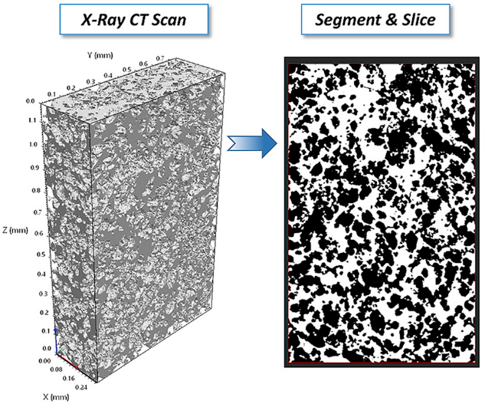
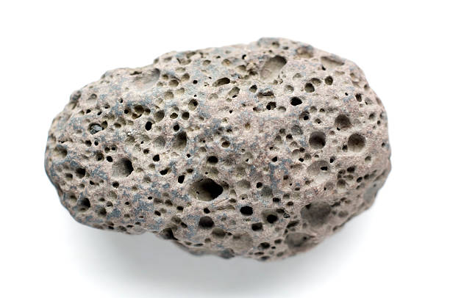
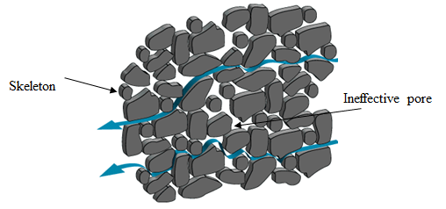
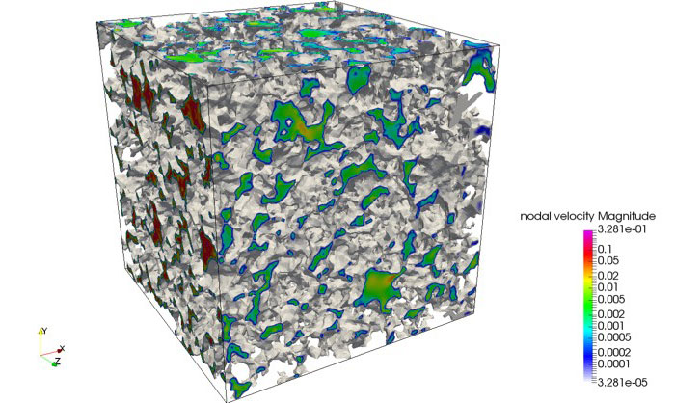
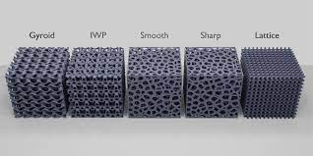
Complexity of Modeling a Porous Medium
SEM image of a PORE
Air
Solid

Slide 5
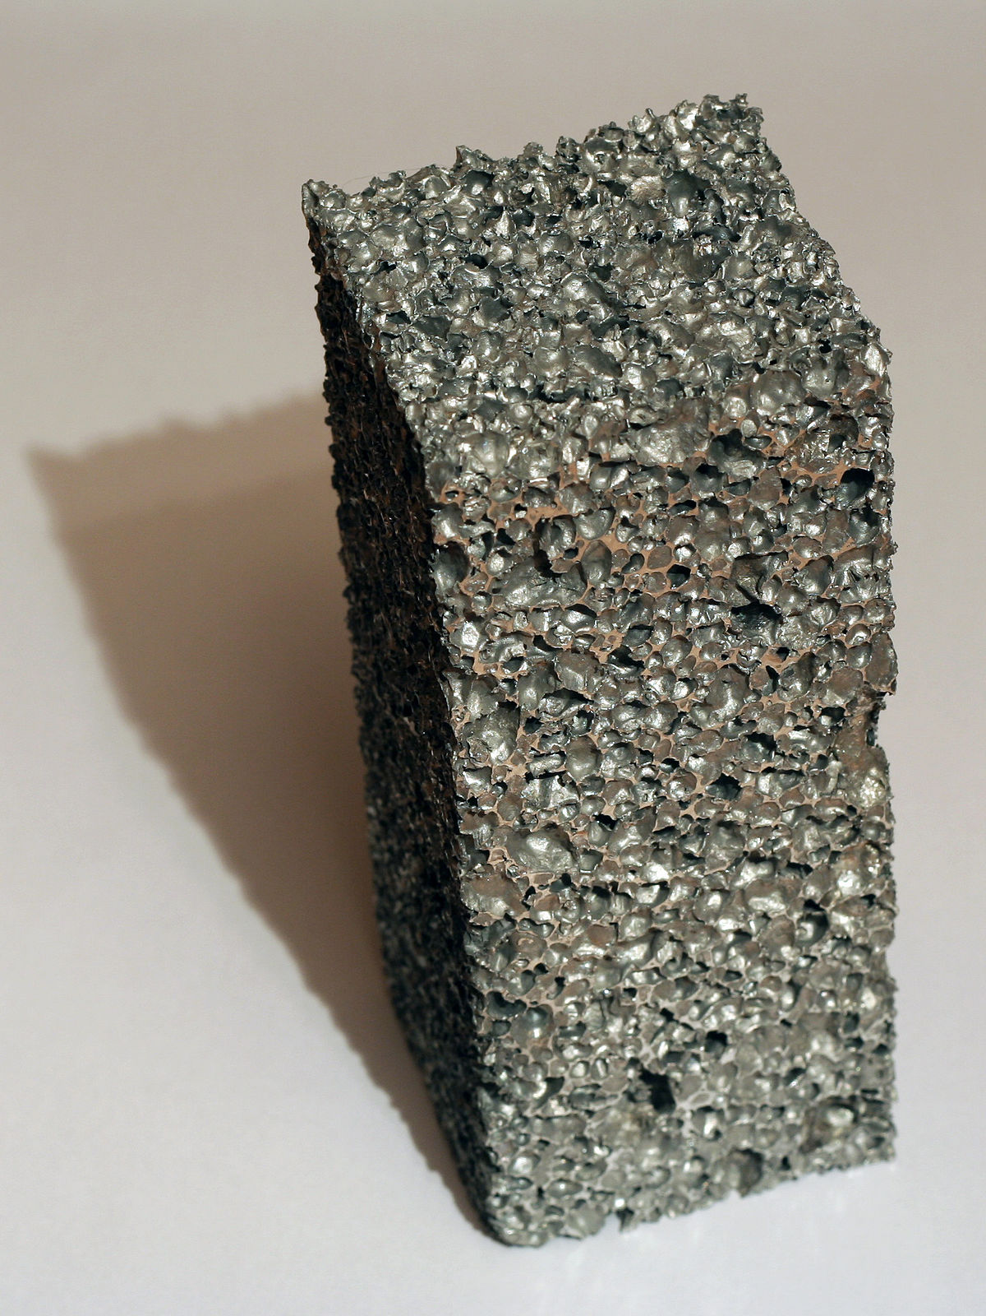
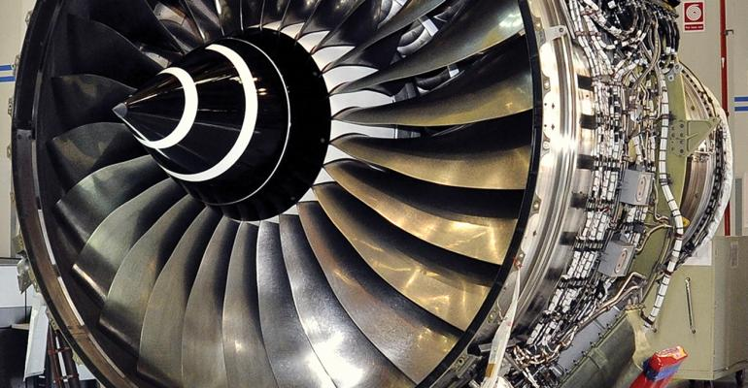
Problem 1
Metal Matrix Composite
Matrix Metal Composite: composite of metal + metal/ ceramic/ polymer or an organic compound.
>> Improved properties of interest.
>> Widely used in automobile, aerospace, biomedical, and many other industries
The matrix
The Reinforcement
The interface
Void pockets >> leading cause of failure
Optimum flow pressure >> minimize void pocket frequency

Slide 6
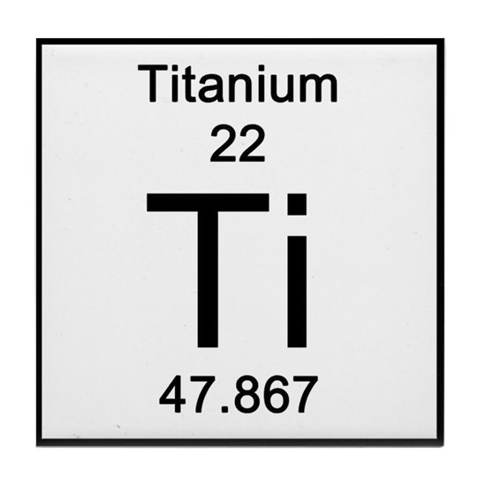
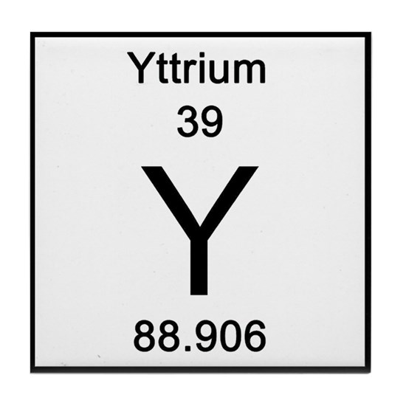
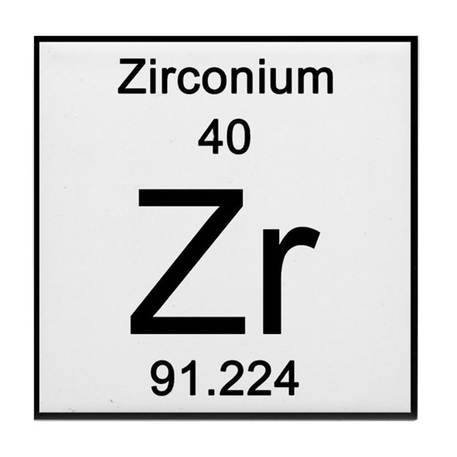
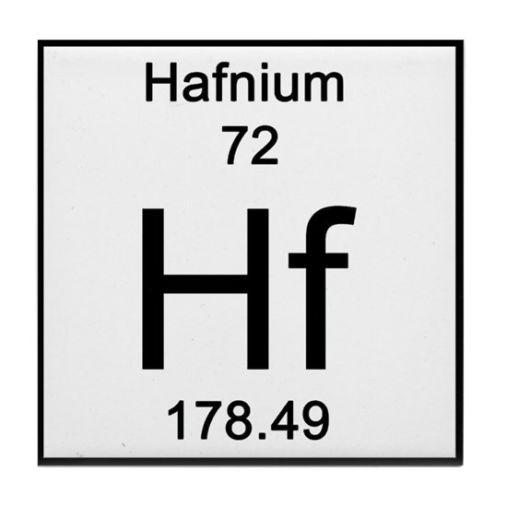
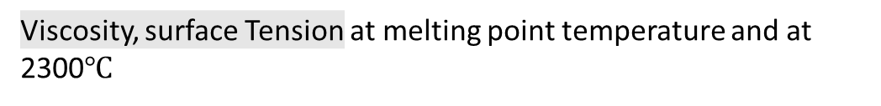
Problem 1
Metal Matrix Composite
desired properties of the product, interaction of the materials, manufacturing process, and cost of production
High strength Good stiffness Light-weight
Higher hardness
Excellent quality of refractoriness High resistance to abrasion, thermal shock and chemical attack
Heat resistivity
Ceramic Matrix
Viscosity, surface Tension at melting point temperature and at 2300$℃$

Slide 7

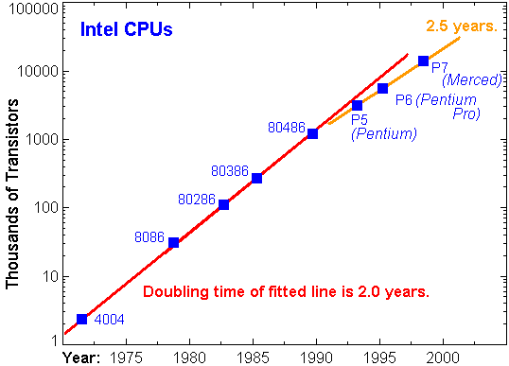
Problem 2
Heat management challenge of Electronics
Electronic devices/ Microprocessors
Demand for Speed and capacity
Size
Power consumption
Heat production
Heat removal -- bottle-neck problem >> Moore's Law
Why size matters?
 | Chips per wafer Yield Cost Efficiency |  | Electric signal travel distance
Micro-pillared cooling system
High Heat Removal Rate
Small Size
Self-operating
No Maintenance
Doesn’t Consume any Power
Moore’s Law is slowing down

Slide 8
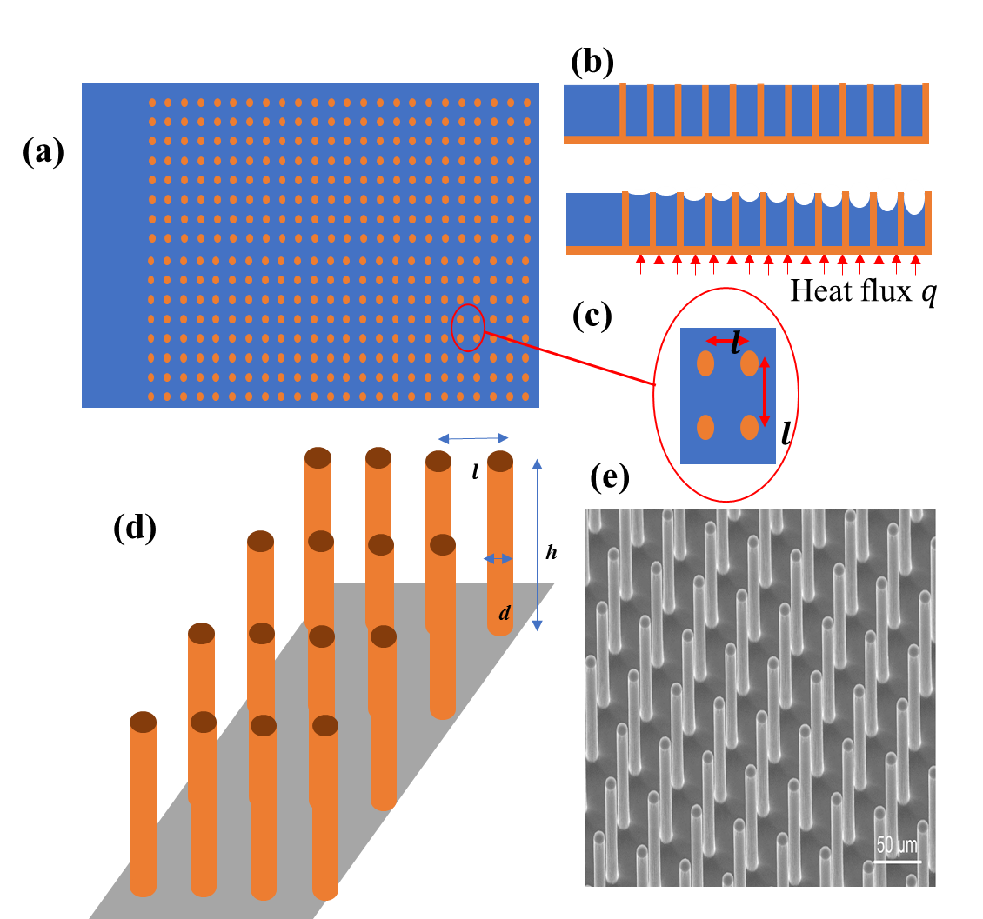
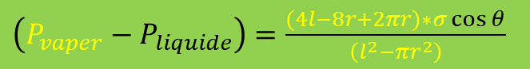
Micro Pillared Cooling System
Micro sized wick structures- responsible for capillary flow
Water comes from reservoir, take the heat and gets evaporated
High specific heat & Latent heat of vaporization > > > High heat removal rate
Continued supply of water >>> continued operation
Top View
Side View
Water Flow direction
Reservoir
10 µm
Flow ends when contact angel is minimum-- as no meniscus forms
Water Flow direction
Microscopic SEM Image
3D View
Young−Laplace equation
$\left(P_{vaper}−P_{liquide}\right)=\frac{(4l−8r+2πr)∗σ\cos{θ}}{\left(l^{2}−πr^{2}\right)}$

Slide 9
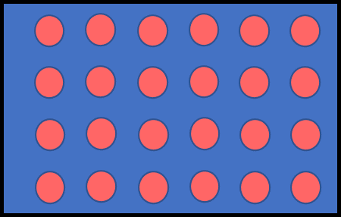


Variance in Diameter
Continued
Prediction and Characterization of Dry-out Heat Flux in Micropillar Wick Structures
Optimum ratio of diameter, height and pitch for the cylindrical type wick structure maximum heat flux
Not Full domain considered >>> Extrapolated from one cell simulation result
No variance of diameter/ height & distance is considered
***We only consider the effect of diameter variance***
Why Variance
Include the manufacturing error
Zhu, Yangying, et al. "Prediction and characterization of dry-out heat flux in micropillar wick structures." Langmuir 32.7 (2016): 1920-1927.

Slide 10
Exa-Scale Pore Network Simulator (EXPNS)
An algorithm developed and implemented in C++ at our lab to solve the porous media flow physics.
Considers both pore scale and network scale flow
Exa-scale computing capability-- 10¹⁸ floating point operations per second
2D flow analysis only
t=0
Does not consider the effect of gravity (Horizontal flow)
t>0
Invading Fluid
Defending Fluid

Slide 11
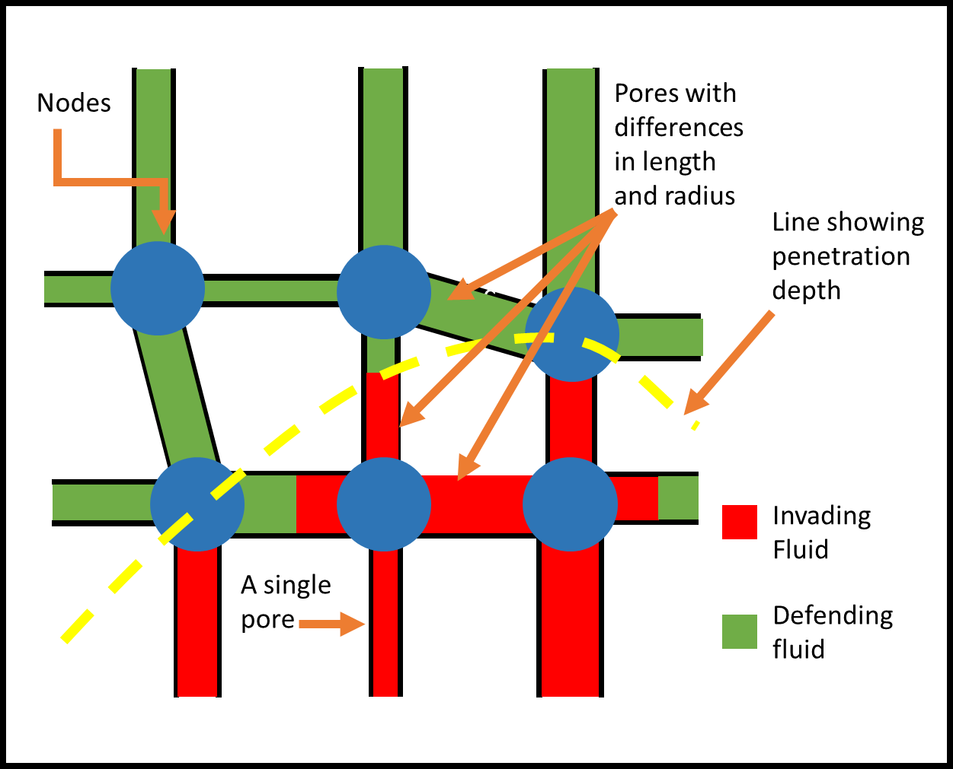
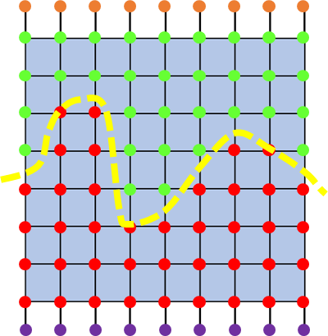
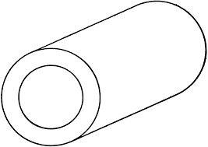
Modeling of Exa-Scale Pore Network Simulator (EXPNS)
Pores >> cylindrical pipes
All the pipes are connected to others through node points
Pore Diameter and length is generated by a random number generator which flows a statistical distribution curve (acquired from CAT scan)
a)
Magnified Picture
b) Total Domain
No Calculation Nodes
Output nodes
Input nodes
Length
Single Pore
Calculation Nodes
Invading fluid
Defending fluid
Diameter
Diagram of an EXPNS network

Slide 12
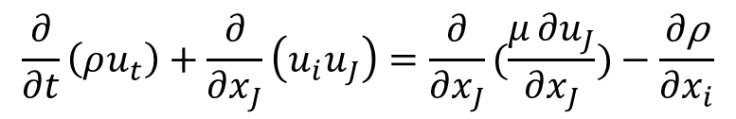
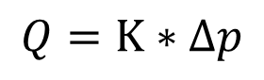
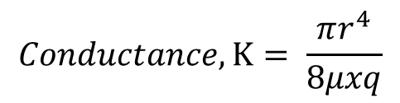
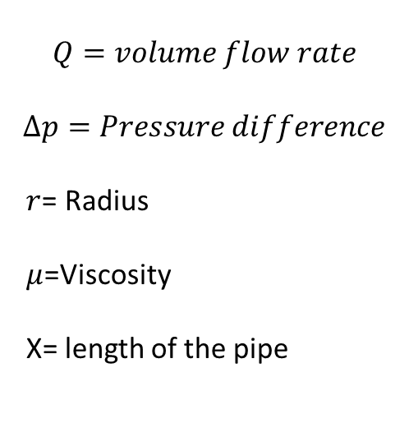
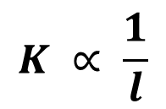
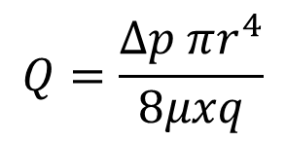
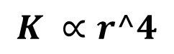
Equation of Conductance
Navier-Stokes formulation :
(Modified Euler Equation)
$$Q=volume flow rate$$
$$∆p=Pressure difference$$
$r$= Radius
$μ$=Viscosity
X= length of the pipe
$$\frac{∂}{∂t}\left(ρu_{t}\right)+\frac{∂}{∂x_{J}}\left(u_{i}u_{J}\right)=\frac{∂}{∂x_{J}}(\frac{μ∂u_{J}}{∂x_{J}})−\frac{∂\text{ρ}}{∂x_{i}}$$
After solving with three considerations:
$$Q=\frac{∆p πr^{4}}{8μxq}$$
Incompressible
Axis-symmetric
$$Conductance,K= \frac{πr^{4}}{8μxq}$$
Length
Laminar
$$Q=K∗∆p$$
$$K ∝r^4$$
$volume flow rate$ = Conductance * Pressure difference
$$K ∝ \frac{1}{l}$$
Diameter
$$V=IR$$

Slide 13
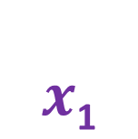
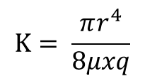
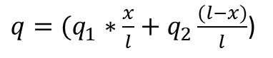
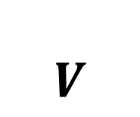
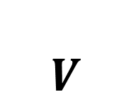
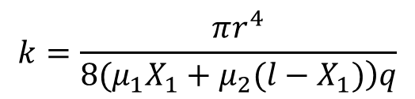
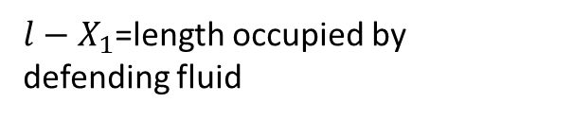
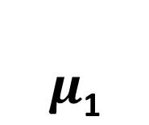
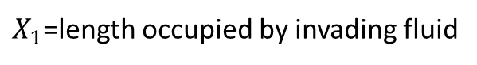
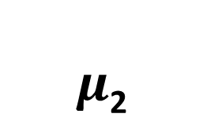


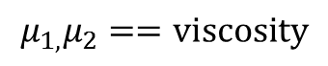
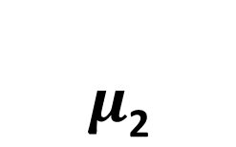

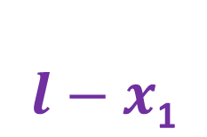
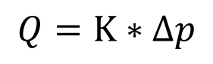
Equation of resistance modification for two liquid flow
$$Q=K∗∆p$$
a)
$$r$$
$$μ\text{1}$$
$$K= \frac{πr^{4}}{8μxq}$$
$$V$$
1
$$x$$
$q=(q_{1}∗\frac{x}{l}+q_{2}\frac{(l−x)}{l}$)
b)
$$k=\frac{πr^{4}}{\left.8(μ_{1}X_{1}+μ_{2}(l−X_{1})\right)q}$$
$$r$$
$$μ\text{2}$$
$$μ\text{2}$$
$$μ_{1,}μ_{2}==viscosity$$
$$x\text{1}$$
$$V$$
$$l−x\text{1}$$
$X_{1}$=length occupied by invading fluid
$l−X_{1}$=length occupied by defending fluid

Slide 14
Pipe Network
Resistance Network
Nodes
R_{ij}
P₂₁
P_{ij}
R₂₁
R₂₂
R₂₃
P₁₁
P₁₂
P₁₃
R₁₁
R₁₂
R₁₃

Slide 15
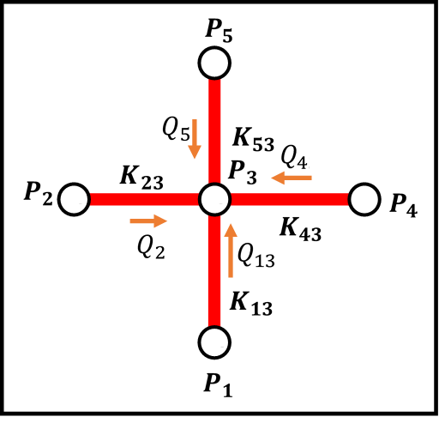
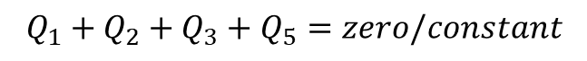
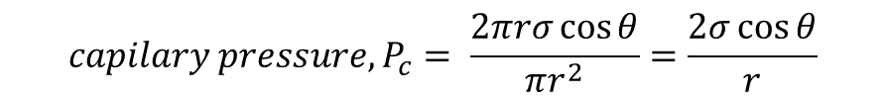
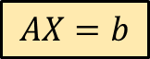
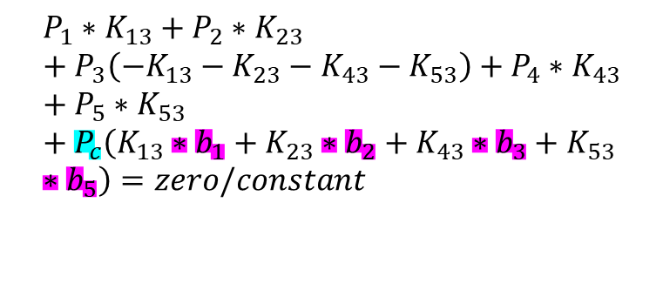
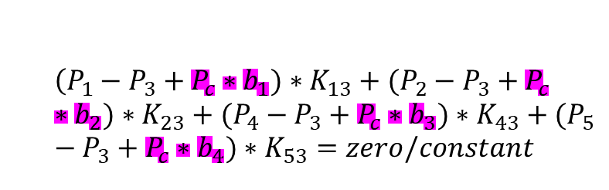
Equations for Nodes
$$Q_{1}+Q_{2}+Q_{3}+Q_{5}=zero/constant$$
Constant if fluid is leaking/ evaporating at a constant rate
$$\left(P_{1}−P_{3}+P_{c}∗b_{1})∗K_{13}+(P_{2}−P_{3}+P_{c}∗b_{2})∗K_{23}+(P_{4}−P_{3}+P_{c}∗b_{3})∗K_{43}+(P_{5}−P_{3}+P_{c}∗b_{4})∗K_{53}=zero/constant\right.$$
$$P_{1}∗K_{13}+P_{2}∗K_{23}+P_{3}\left(−K_{13}−K_{23}−K_{43}−K_{53}\right)+P_{4}∗K_{43}+P_{5}∗K_{53}+P_{c}\left(K_{13}∗b_{1}+K_{23}∗b_{2}+K_{43}∗b_{3}+K_{53}∗b_{5}\right)=zero/constant$$
$$capilary pressure, P_{c}= \frac{2πrσ\cos{θ}}{πr^{2}}=\frac{2σ\cos{θ}}{r}$$
2
$$AX=b$$
GMRES Method

Slide 16
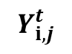
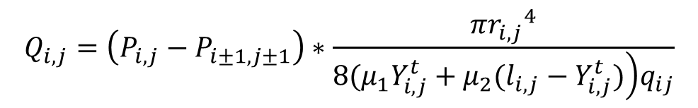
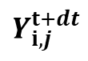
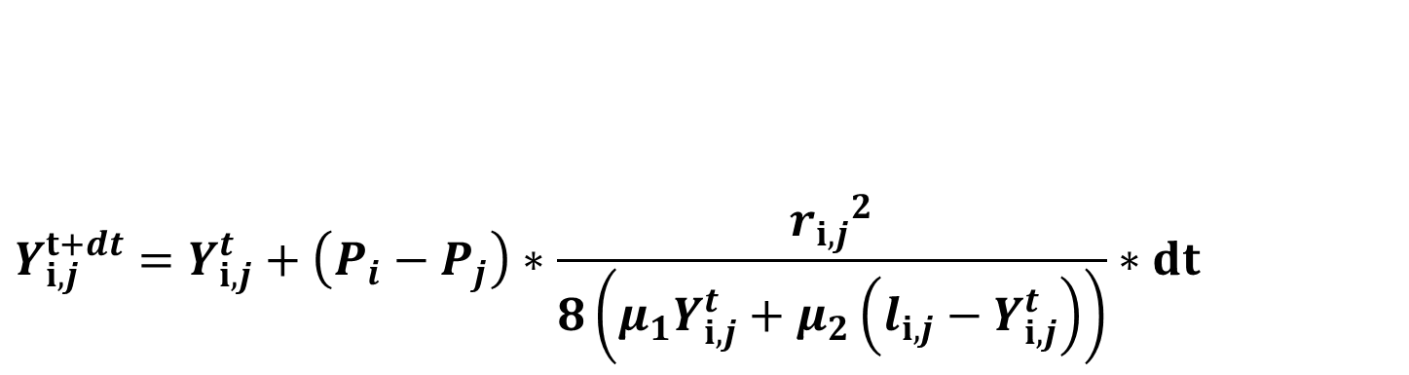




Modified Nodal analysis
$Q=∆p$* $\frac{πr^{4}}{\left.8(μ_{1}X_{1}+μ_{2}(l−X_{1})\right)q}$
$$Q_{i,j}=\left(P_{i,j}−P_{i±1,j±1}\right)∗\frac{π{r_{i,j}}^{4}}{\left.8(μ_{1}Y_{i,j}^{t}+μ_{2}(l_{i,j}−Y_{i,j}^{t})\right)q_{ij}}$$
$$Y_{i,j}^{t}$$
$$Y_{i,j}^{t+dt}$$
$$\frac{dY_{i,j}}{dt}=\left(P_{i}−P_{j}\right)∗\frac{{r_{i,j}}^{2}}{\left.8(μ_{1}Y_{i,j}^{t}+μ_{2}(l_{i,j}−Y_{i,j}^{t})\right)q_{ij}}$$
As $Q=πr^{2}∗ \frac{dy}{dt}$
$$Y_{i,j}^{t+dt}=Y_{i,j}^{t}+\left(P_{i}−P_{j}\right)∗\frac{{r_{i,j}}^{2}}{8\left(μ_{1}Y_{i,j}^{t}+μ_{2}\left(l_{i,j}−Y_{i,j}^{t}\right)\right)}∗dt$$
3
$${∗q}_{ij}$$

Slide 17
Algorithm
Take the inputs
1
Generate Pore length & Diameter (2N^2)
Calculate Conductance for the pores in transition. (N to 2N)
Calculate Pressure at each calculation node (N^2)
Calculate the liquid progression in each pores in transition (N to 2N)
Update the journal for pore liquid ratio (N to 2N)
0<t<T
2
Determine Initial Conductance for each pore (2N^2)
1
Assign pressure to all nodes (2N+N^2)
3
Output data

Slide 18


Parameters We Give Input
Density of two Fluids: Temperature dependent
Viscosity of 1st & 2nd Fluid: Temperature dependent
Flow of one fluid in initially empty pores
Contact angle: 1st and 2nd fluid and the solid body material
2nd Fluid viscosity $≅0$
Surface Tension: 1st and 2nd fluid
2nd Fluid surface tension = 0
2nd Fluid Density $≅0$
Time step size: Usually 0.1s
Total Time: No limits, depends on the matrix size
Size of the matrix: Length & width- given input as the number of nodes; say 100000*100000
Pressure Difference: => 10 Pa
Pore Geometry Distribution Curve (Optional)

Slide 19

Validation of EXPNS
For Validation of EXPNS, it is compared with the capillary flow through a capillary tube predicted by Rhine’s Equation
$$\frac{d}{dt}\left(ρπr^{2}h\frac{dh}{dt}\right)=2πrσ\cos{θ−8πμh\frac{dh}{dt}}$$
Rhines Equation
Source:“V. Kumar, C. K. Harris, A. Bronson, S. Shantha-Kumar, and A. Medina, “High-Temperature Liquid Metal Infusion Considering Surface Tension-Viscosity Dissipation,” Metall. Mater. Trans. B Process Metall. Mater. Process. Sci., vol. 47, no. 1, pp. 108–115, 2016.
Vs
Vs
EXPNS
Rhines Equation
EXPNS
Rhines Equation
Single Fluid Flow
Two Fluid Flow

Slide 20







Problem 2
Conductance Finding
Outlet, pressure 0
Pillar 2
We considered the $h=3 μm$ and $l=9 μm$
$$d=1 to 5 μm (1 increment)$$
Pillar 1
Inlet
15 combinations
Avg h$eight(water)=0 to 2 μm$ (0.5 increment) >>> 5 counts
75 combinations
Flow rate = Pressure Diff * conductivity

Slide 21
Change of Flow Rate with Pressure Difference
Dia 1= 2 & Dia 2 = 3

Slide 22
Results

Slide 23
Validation of EXPNS: Results
Single Fluid

Slide 24
Validation of EXPNS: Results
Continued
Two Fluids

Slide 25








Notes:
This is the infiltration of zirconmium at melting temperature and at twenty hundred degrees celsius

Slide 26








Notes:
This is the infiltration of titanium at melting temperature and at twenty hundred degrees celsius

Slide 27


Comparison
T=50s
Element | Temperature | Surface Tension (σ) Nm⁻¹ | Viscosity (µ) 10³ kgm⁻¹s⁻¹ (Pa-s) | Density (ρ) 10⁻³ kgm⁻³ | $$\overline{y}(10^{2}μm)$$
Hafnium | 2300 | 1.60 | 6.69 | 11.8 | 1.1
Titanium | 2300 | 1.44 | 2.16 | 4.03 | 1.9
Yttrium | 2300 | 0.765 | 0.491 | 3.99 | 4
Zirconium | 2300 | 1.41 | 3.00 | 6.09 | 1.75
Element | Melting Temperature (°C) | Surface Tension (σ_{mp}) Nm⁻¹ | Viscosity (µ_{mp} 10³) kgm⁻¹s⁻¹ (Pa•s) | Density (ρ_{mp} 10⁻³) kgm⁻³ | $$\overline{y}(10^{2}μm)$$
Hafnium | 2231 | 1.612 | 7.1 | 11.82 | 1.00
Titanium | 1668 | 1.555 | 3.3 | 4.17 | 1.60
Yttrium | 1522 | 0.804 | 4.54 | 4.15 | 1.30
Zirconium | 1855 | 1.464 | 4.74 | 6.21 | 1.40
Temp
Density
Viscosity
Depth of penetration

Slide 28

Flow example
𝑌 cm
X 𝜇𝑚
Depth of Penetration
Max
Avg
Min

Slide 29



Conclusion
Future Scopes
EXPNS:
Schiaffino, A, Chattopadhyay, A, Hossain, ST, Kumar, V, Kotteda, VMK, & Bronson, A. "Computational Study of High Temperature Liquid Metal Infusion."
Kotteda, V.M.K., Schiaffino, A., Chattopadhyay, A. et al. Sensitivity of Viscosity on Molten Ti Infusion into a B4C-Packed Bed at the Microscale.
Chattopadhyay, A, Kotteda, VMK, Kumar, V, & Spotz, W. "Next Generation Exascale Capable Mutliphase Solver With Trilinos."
Considering 3D
Heat Transfer
Metal Matrix Composite:
Finding out the optimum pressure
Micro-pillared cooling system:
Considering Height and pitch variance
Finding an optimum distribution

Slide 30
Acknowledgement
Thesis Supervisor
Dr. Vinod Kumar
Dr. Kumar’s Research Group Members
Specially:
Ashesh Chattopadhyay
Arturo Shafino
Dr. V M Kotteda
Department of Computational Science
University of Texas at El Paso

Slide 31
Machine Learning Assignment
Data set:
It’s a feature table that contains 34553 samples. The “Class” column is the label. All other columns except for the first three columns (ID, Time, Group) are the features of the samples. The objective is to train a supervised model that takes features of new samples to predict the Class.
Any pre-processing of the data we should do before training a model
Build a classifier model.
Show the model performance, both overall and per class. For example, precision and recall. Show them in tables or plots.
Show any insight you uncover.
http://localhost:8888/notebooks/Desktop/Interview%20Intel/Interview_code_solve.ipynb

Slide 32
Thank You

